Slide 1
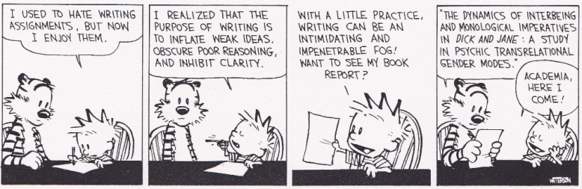
ENGR101 Foundations of Engineering Lecture 7 2017 report writing

Slide 2
What we going to cover
Structure of a report
Report style
Clear writing suggestions (not an English writing lecture)
Structure of a paragraph
Structure of a sentence

Slide 3
Goal of Report Writing
Clear & concise communication of ideas, results, conclusions, etc.
Contribute to decision making: Engineering Process – Decide
Document work for future reference
Build & Deliver and Operate often refer to earlier work.
It is the ENGR101 assignment ☺ (issued on Friday)
Good writing takes
Time for revision/rough drafts/feedback
Lots of practice
Practice heaps
Whole bunch of repetition
significant practice!

Slide 4
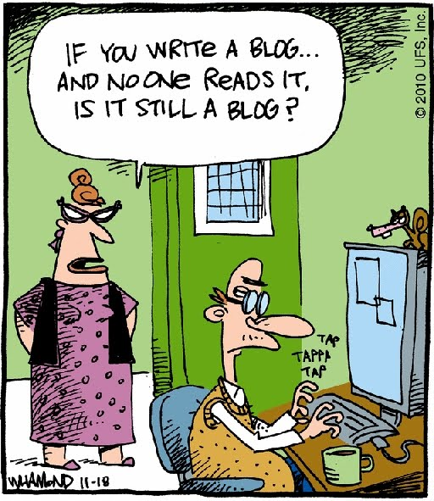
Report Writing
If you write an engineering report and no one can understand it, is it still a report? Are you still an engineer?
Engineers write many, many reports.
Typical parts for a report include:
Different courses, assignments, employers, etc. can require different structures (e.g. assignment #1 has no methods section)
always check and follow the rules
Tutor marking 28 reports – give them the sections they expect to see! Use the template we provide
Title Page Summary Table of Contents Introduction Background/Theory Experimental methods | Results Discussion Conclusions References Appendices

Slide 5
Title Page
Title Page Summary Table of Contents Introduction Background/Theory Experimental methods | Results Discussion Conclusions References Appendices
Short descriptive title
Author’s name, date, other relevant information, etc.
For ENGR101, cover sheet is separate from title page

Slide 6
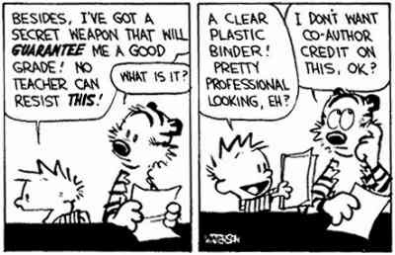
Title Page
Simple, informative and concise
Staple in upper left corner (must do this)
Include your name
Include other relevant details
WORD ART
Color folders
Plastic binders
Ideas matter!
Style should be invisible.

Slide 7
Title Page
Ideas matter!
Style should be invisible.
Simple, informative and concise
WORD ART
Color folders
Plastic binders
Staple in upper left corner (must do this)
Include your name
Include other relevant details

Slide 8
Title Page
Ideas matter!
Style should be invisible.
Simple, informative and concise
WORD ART
Color folders
Plastic binders
Staple in upper left corner (must do this)
Include your name
Include other relevant details

Slide 9
Title Page
Ideas matter!
Style should be invisible.
Simple, informative and concise
WORD ART
Color folders
Plastic binders
Staple in upper left corner (must do this)
Include your name
Include other relevant details

Slide 10
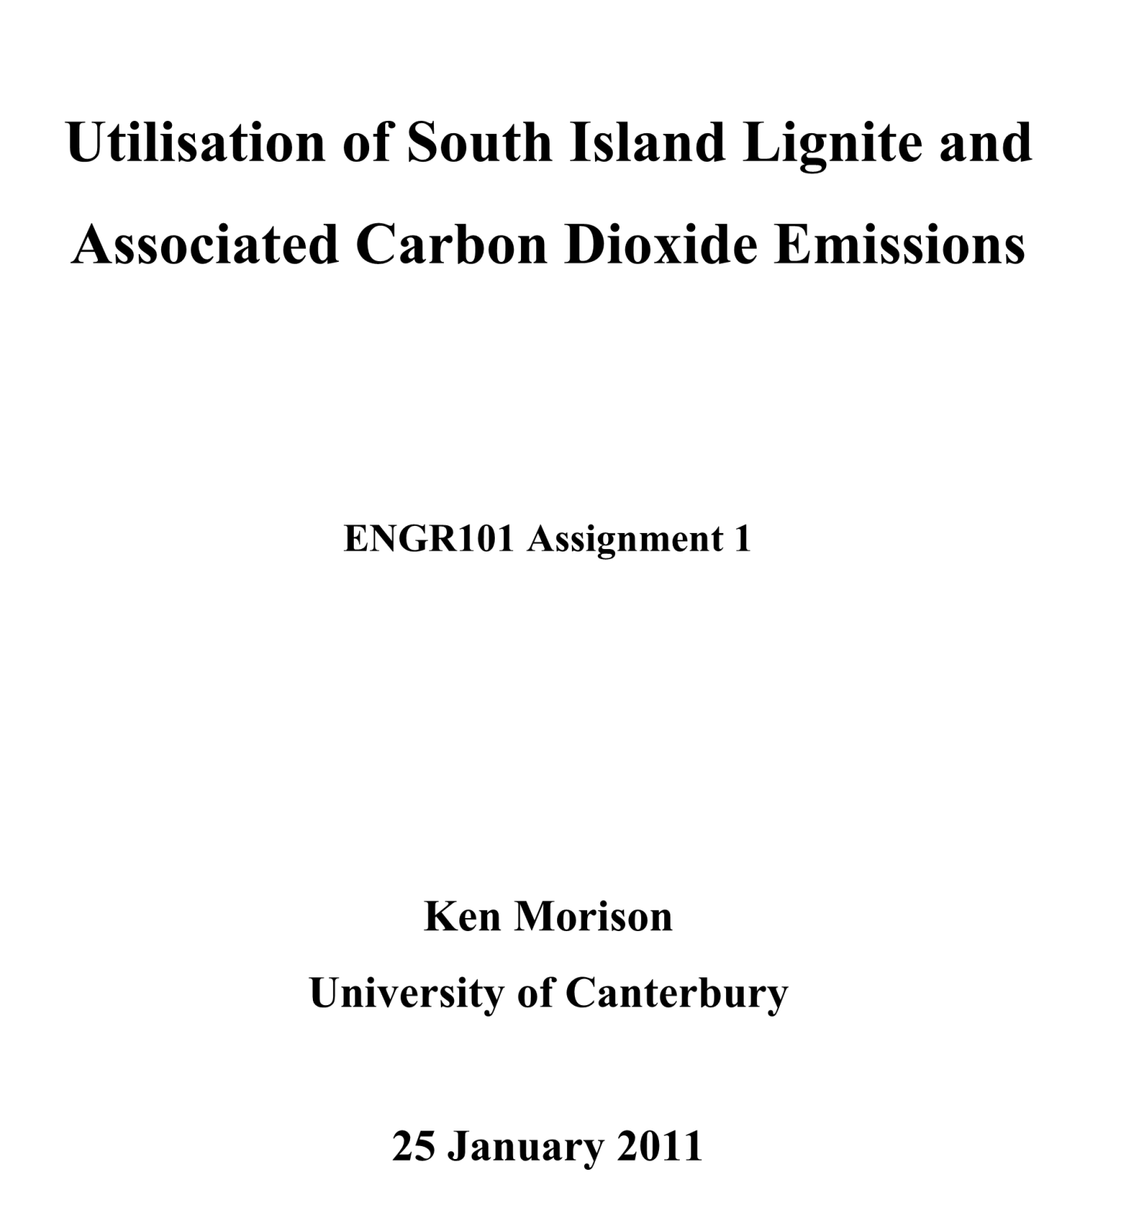

Slide 11
Summary (or Abstract)
Title Page Summary Table of Contents Introduction Background/Theory Methods | Results Discussion Conclusions References Appendices
Very important part of a report
Often the only part your boss reads
Briefly summarizes the whole report
First section of a report, but always written last!
Should be able to be read as a stand-alone document
NO referencing to other parts of the report
You must, Must, MUST include important specific details in your summary. Most engineering reports will have numbers in the summary!
Avoid excessive background information (save for Introduction)

Slide 12
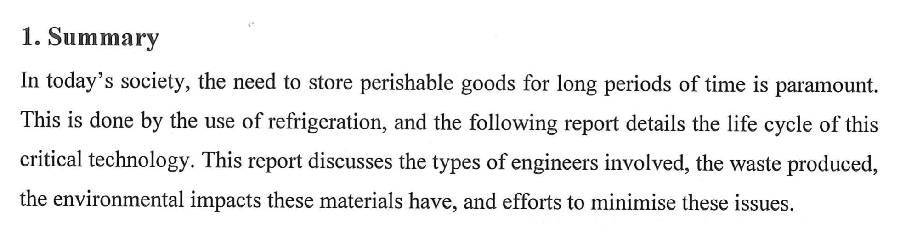
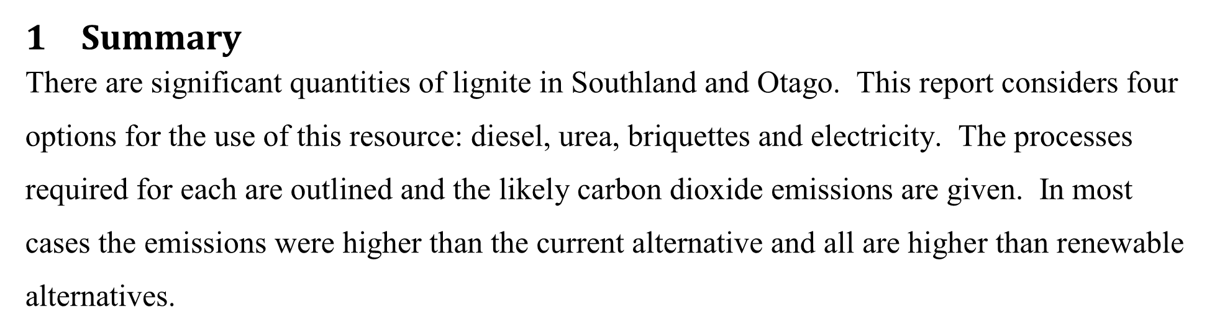
Ok but lacking details, 1/3 of content is background
Much better detail, more would be better
“higher” & “significant” are a vague terms, define “current alternative”

Slide 13
“This experiment investigated several different measurement techniques and different methods of calculating uncertainties. The period of a pendulum was measured using a stop watch. The period was 1.64 ± 0.03 s estimated from 10 trials. The 95% confidence interval was the best method of uncertainty because …”

Slide 14
Introduction & Background sections
What is the report about?
Aim & background
What is the starting point?
Prior knowledge
Must be referenced
Title Page Summary Table of Contents Introduction Background/Theory Methods | Results Discussion Conclusions References Appendices

Slide 15
References
Not referencing ideas, data, pictures, etc. is:
Plagiarism
Cheating
Stealing
If you copy a few sentences without adding quotation marks
If you copy a few sentences without citing your source
If you take someone else’s ideas without citing where you took the ideas from
If you change a few words from text you copied and pasted
You do not reference the source for the image you downloaded

Slide 16
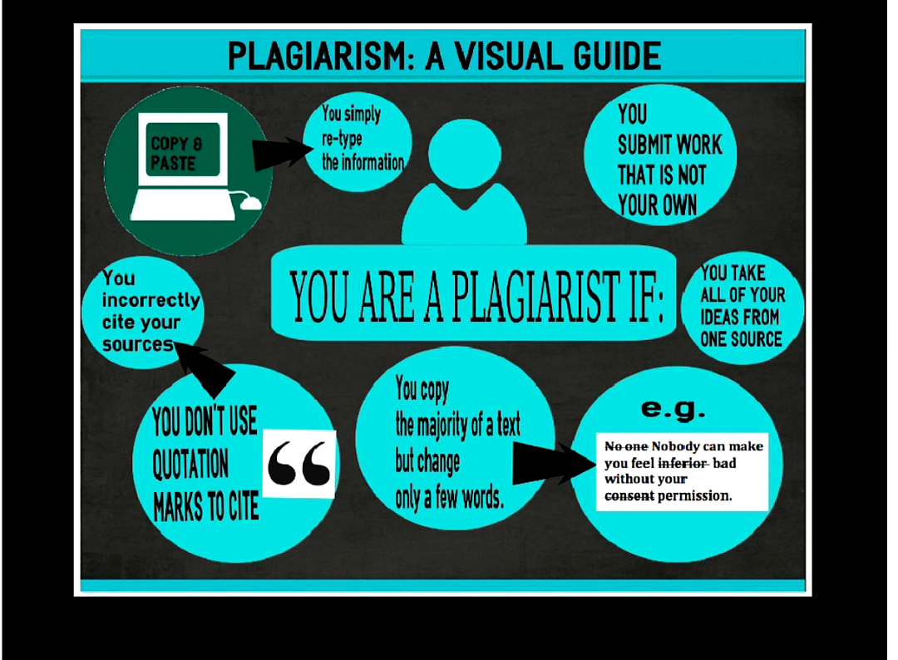

Slide 17
Other sections
Title Page Summary Table of Contents Introduction Background/Theory Methods | Results Discussion Conclusions References Appendices
Other sections more obvious
Some formatting comments:
Equations are numbered
The frictional pressure drop can be calculated from the velocity, as follows:
ΔP_{f} = 4fL/D*ρu²/2 (1)
The frictional pressure drop ΔP_{f} is related to the pipe length (L) and fluid density (ρ) (Eq. 1).

Slide 18
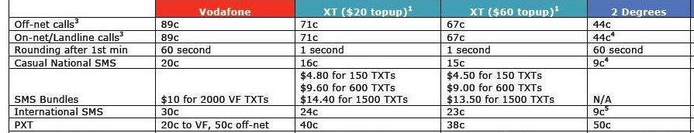
Formatting – tables & figures
Tables
Need caption above the table
Caption should be a complete sentence (including punctuation)
Need to be referenced in text before they appear
The costs of calls to landlines vary by over 100% between different mobile packages in New Zealand (Table 1). Recent developments …
Table 1 – Mobile phone plans in New Zealand compared by calling and text costs in 2009 (iphonewzealand, 2010).

Slide 19
Formatting – tables & figures
Figures = graphs, pictures, photos, drawings, etc
Figure caption goes below the figure
Caption → complete sentence
Reference in text before it appears.
Ideally text in figures should be similar font size to body text

Slide 20
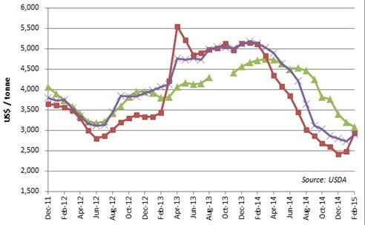
Wholesale milk powder prices fell in 2014 by 60% but have risen in early 2015 (Fig. 1). Other key observations include the difference between ..
Graphs do not have titles in engineering reports
Fig. 1 – The selling price of wholesale milk powder prices in the US, EU and Oceania between Dec 2011- Feb 2015 reported on a monthly basis (dairyco.org.uk).

Slide 21
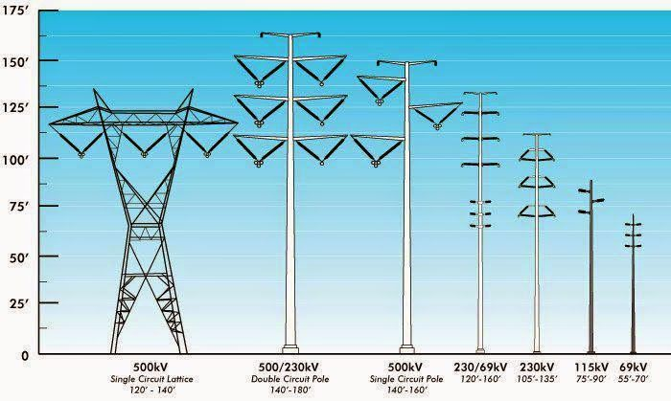
Towers of various shapes and heights (from 14 metres to more than 100 metres) support high-voltage conductors (Fig. 2). The towers may be of metal lattice, concrete or wood.
Figure 2 – The types of high voltage transmission towers in New Zealand vary by voltage (http://electrical-engineering-pics.blogspot.co.nz, 2016).

Slide 22

Conclusions
Cover important points mentioned in DISCUSSION
Don’t waffle → be concise and clear
Bulleted or numbered points are fine, but you must include introductory text
If a point is not in the DISCUSSION, do not include it here (if important add it to discussion!)
Title Page Summary Table of Contents Introduction Background/Theory Methods | Results Discussion Conclusions References Appendices

Slide 23
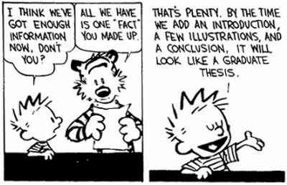
Conclusions Example
Introductory text
Three main conclusions were drawn from the investigations carried out in this project:
(a) Joe Frazier’s “sledgehammer” left hook gave him a considerable advantage when fighting other boxers.
(b) George Foreman’s reputation as a bully was well-deserved, although not in comparison with later boxers such as Mike Tyson.
(c) Ali’s “rope-a-dope” strategy enabled him to absorb punishment when fighting Foreman in Zaire, allowing him to use his speed and impact when Foreman briefly let his defences slip.

Slide 24
Paragraph style for Conclusions
This project identified three main conclusions about famous heavy weight boxers. The first was Joe Frazier’s “sledgehammer” left hook gave him a considerable advantage when fighting other boxers. The second was George Foreman’s reputation as a bully was well-deserved, although not in comparison with later boxers such as Tyson. Finally, Mohammed Ali’s “rope-a-dope” strategy enabled him to absorb punishment when fighting Foreman in Zaire, allowing him to use his speed and impact when Foreman briefly let his defences slip. While each of these boxers was successful, they had quite different styles.
A paragraph will normally need a concluding sentence

Slide 25
Writing style - paragraphs
A paragraph has a structure:
Paragraph = Topic + Supporting sentences
Topic sentence is main idea of paragraph (usually first)
Supporting sentences amplify/support main idea of topic sentence
Paragraphs can be too long or too short
One idea per paragraph
No 1- or 2- sentence paragraphs, since the main idea will not be properly supported

Slide 26
Writing style - sentences
Be consistent with verb tense
Normally past tense.
If a sentence “sounds” better in present tense rephrase the sentence.
Some things always present tense “the boiling of toluene is 78 ºC”
Avoid 1st Person “I”, “we”, “me” → makes writing very wordy
Active verbs where possible. Watch out for phrases like “It was determined to be larger” , “It appeared to be significant”
→ “It was larger.” “It was significant.”
“We measured the stress on the beam and determined it was 95 MPa”
13 words
See if you can do better

Slide 27
Avoid Long Sentences
Break them up
Look for conciseness
“The nut was sticky taped to the underside of the foil so it could be easily moved to find the right distance from the front it had to be to get the most distance out of the glider”
“The nut was taped lightly onto the underside of the aerofoil. Thus, it was easily moved to optimise the flying distance of the glider.
(38 words )
(11 + 11 = 22 words)

Slide 28
Avoid Long Sentences
“If the drop angle was too steep, the glider would fly straight down into the ground, while if it was too flat, the glider would take too long to get enough speed to create enough lift for it to glide well.”
“With a steep release angle, the glider flew downwards into the ground. However, a too shallow release angle provided insufficient speed and lift for adequate gliding.
(41 words)
(12 + 14 = 26 words)

Slide 29
Short sentences not always best
“This design incorporates a delta wing design. This means that it has a large triangle shaped wing that has a large surface area. This large surface area increases the amount of lift.”
(33 words)
You try

Slide 30
Avoid “get” when another verb would be more precise
Still wordy
“A trial and error method has been used to get the optimum angle of release”
“A trial and error method has been used to find the optimum angle of release”
“The nut should be located x cm from the front of the glider to get a good flight distance”
“The nut should be located x cm from the front of the glider to achieve the optimal flight distance”
(15 words)
A trial and error method determined the optimum angle of release. (11)
The optimum angle of release was found by trial and error. (10)

Slide 31
No contractions
Isn’t → Is not
Doesn’t → Does not
Wasn’t → Was not
Don’t → Do not
Wouldn’t → Would not
Can’t → Can not

Slide 32
Signs of a Possible Passive Sentence
Any form of the verb “to be” -- is, are, was, were, be, been
The design will be checked by the stylist. (passive)
The stylist will check the design. (active)
Any form of the verb “to have” -- have, has, had
The technician had set up the power unit in the lab.
The technician set up the power unit in the lab.
Verbs that were made into nouns
The redesign of the circuit board was done by the electrical engineer.
The electrical engineer redesigned the circuit board.
The circuit board was redesigned by the electrical engineer.

Slide 33
Examples
We measured the temperature of the condensate and determined it was 91 ºC. You try!
The condensate temperature was 91 ºC. (5 vs 12 words)
The substantial growth of the rate of the chemical reaction was mainly a result of the increase in the temperature of the reactor.

Slide 34
Report Writing
In the ENGR101 Learn site the General Resources has useful links. Univ. of Sydney: http://learningcentre.usyd.edu.au/wrise/
The content of this site is very good. Have a look at the Civil or Chemical Engineering reports.
Work through the different sections of each report as shown on the left side of the page in the Sydney site
Academic Skills Centre http://www.lps.canterbury.ac.nz/lsc/

Slide 35

EndNote8
Database program that
Manages your technical references
Endnote can be linked to reference databases like Google Scholar, Web of Science etc
Makes formatting them in Word much, much, much easier.
Useful for your EWB project
All students can get load it on to their profile or their laptop through the Library (do before Design Studio if you can)
http://wiki.canterbury.ac.nz/display/LIBRARY/EndNote

